Slide 1
Weekly Meeting
Feb 16, 2022
Gwangwoo Kim

Slide 2
17. Hierarchical clustering
deterministic
efficiency
K-means
X (predefined)
O(N)
Hierarchical clustering
O
at least O(N^2)

Slide 3
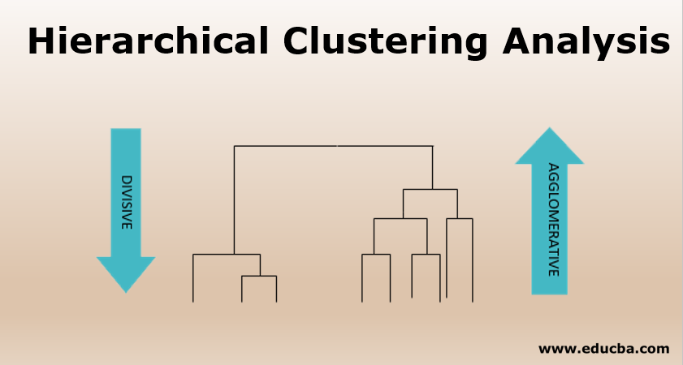
17.1 Hierarchical agglomerative clustering

Slide 4
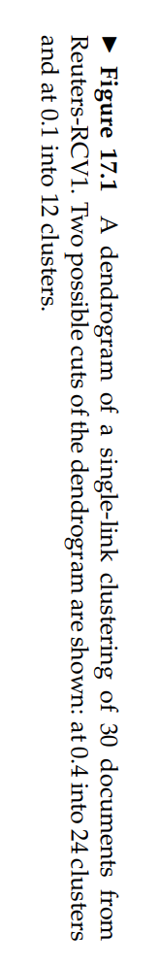
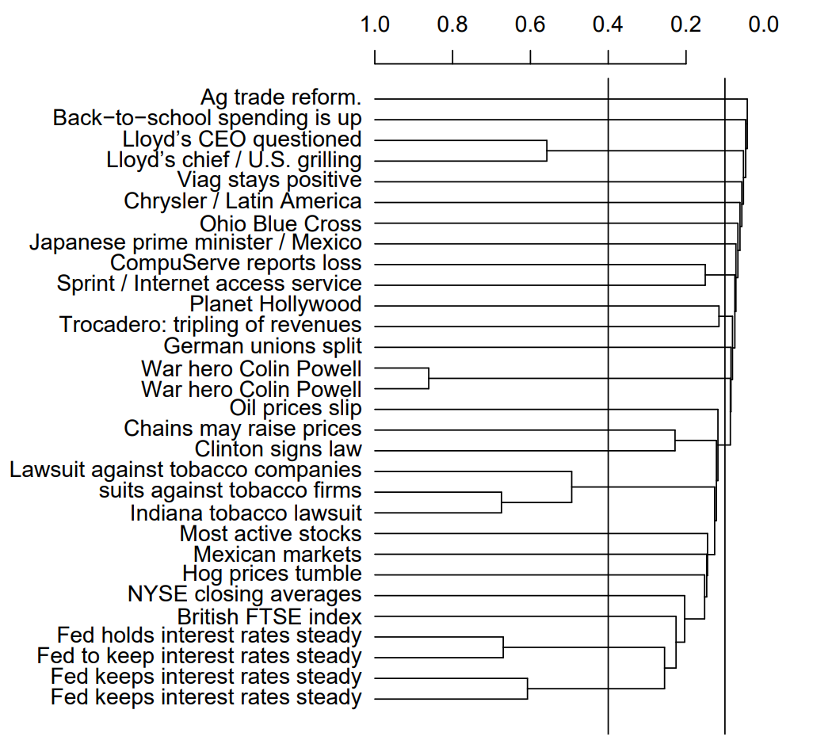
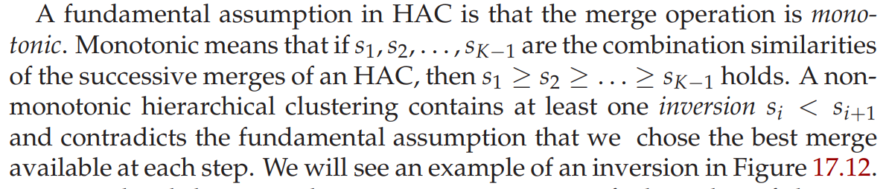
17.1 Hierarchical agglomerative clustering
Hierarchical clustering does not require a prespecified number of clusters. However, in some applications we want a partition of disjoint clusters just as in flat clustering.

Slide 5
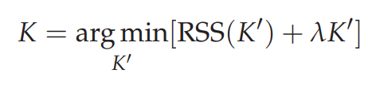
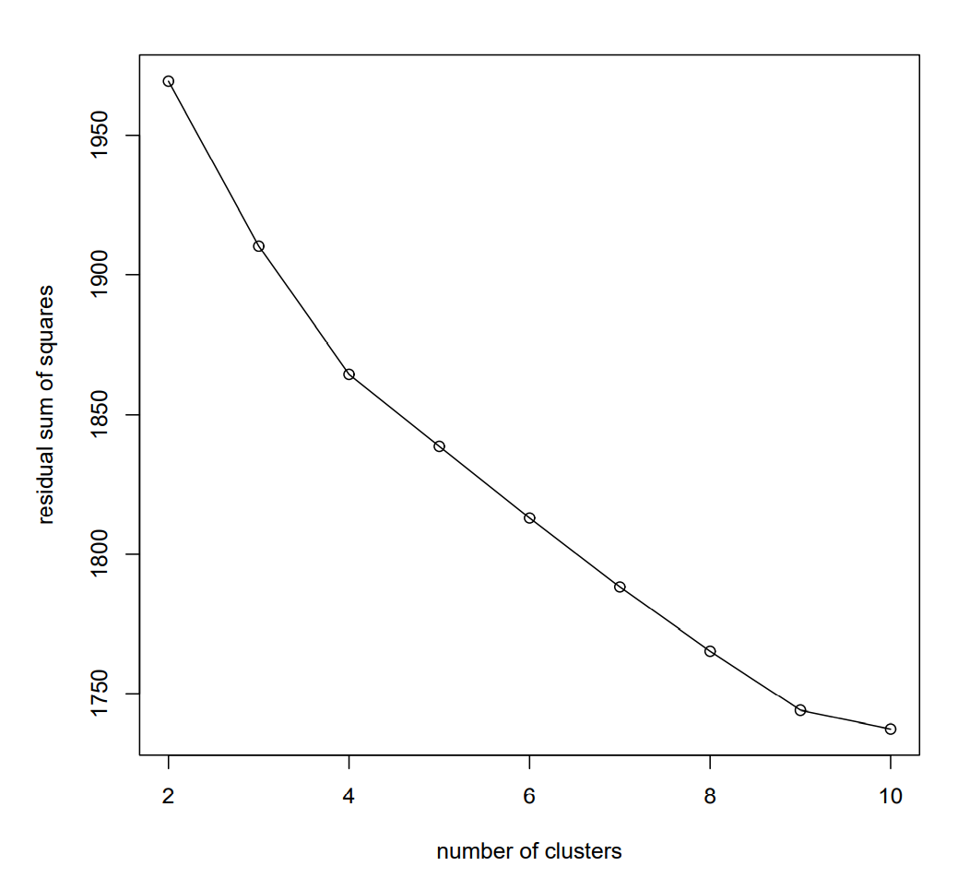
17.1 Hierarchical agglomerative clustering
Cut at a prespecified level of similarity.
Cut the dendrogram where the gap between two successive combination similarities is largest.
Such large gaps arguably indicate “natural” clusterings. This strategy is analogous to looking for the knee
in the K-means graph.
Apply equation
As in flat clustering, we can also prespecify the number of clusters K and
select the cutting point that produces K clusters.

Slide 6
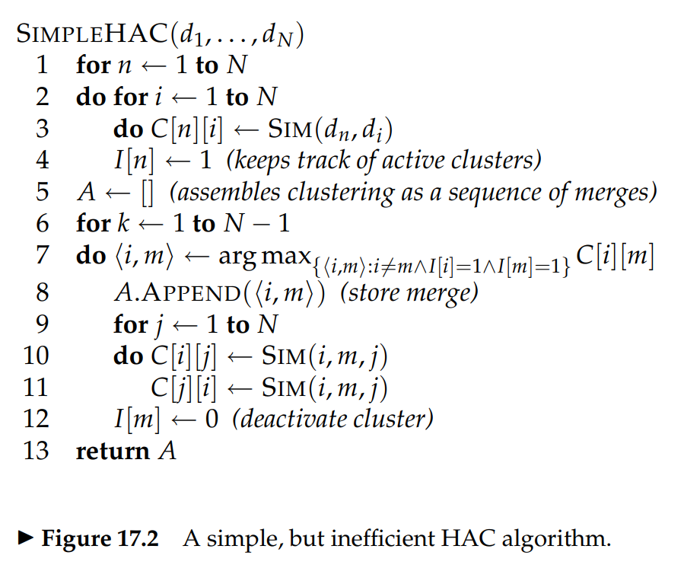
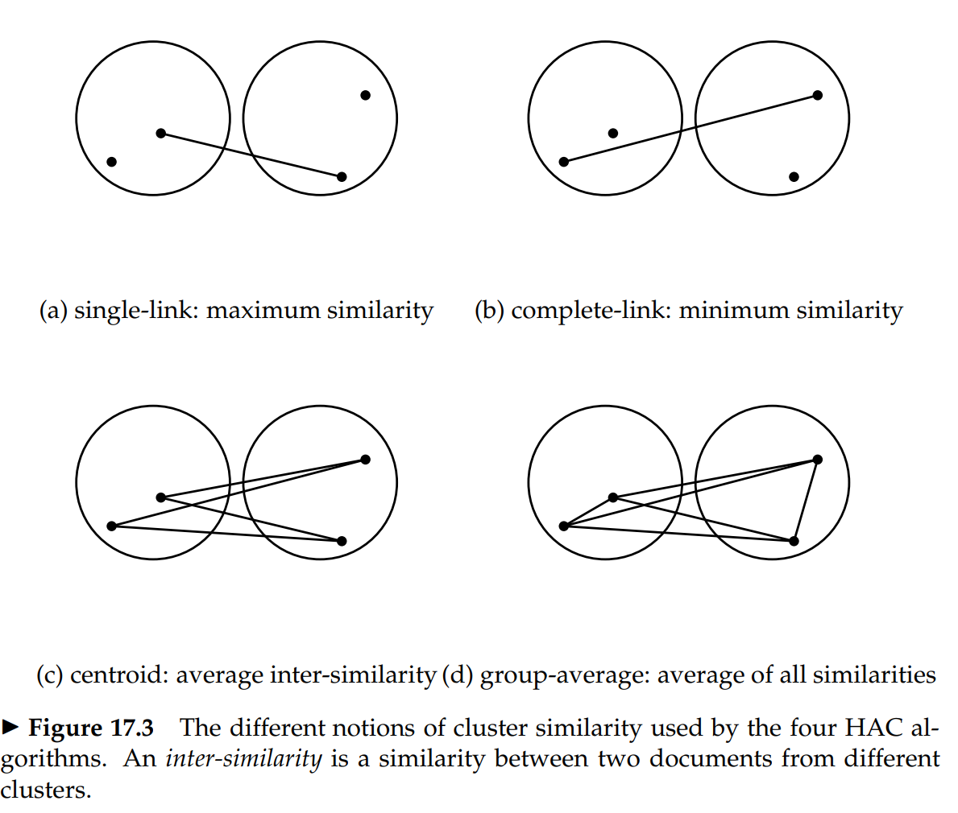
17.1 Hierarchical agglomerative clustering
<Note> The time complexity is O(N^3). It can
be reduced to O(N^2logN). In particular, single-link method can be O(N^2)

Slide 7
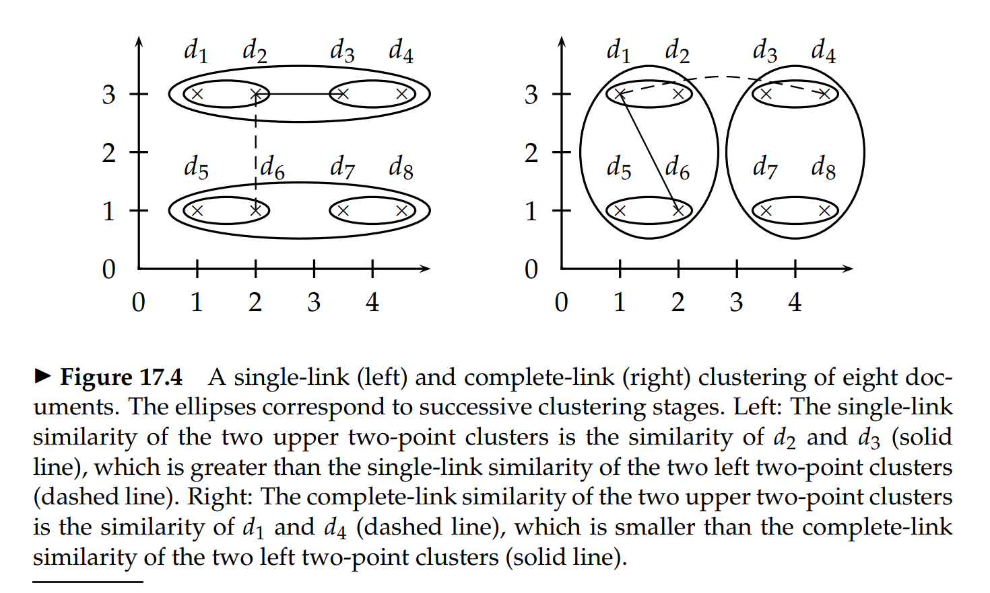
17.2 Single-link and complete-link clustering

Slide 8
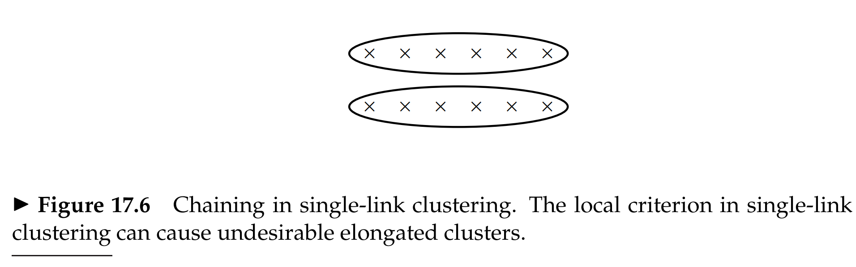
17.2 Single-link and complete-link clustering

Slide 9
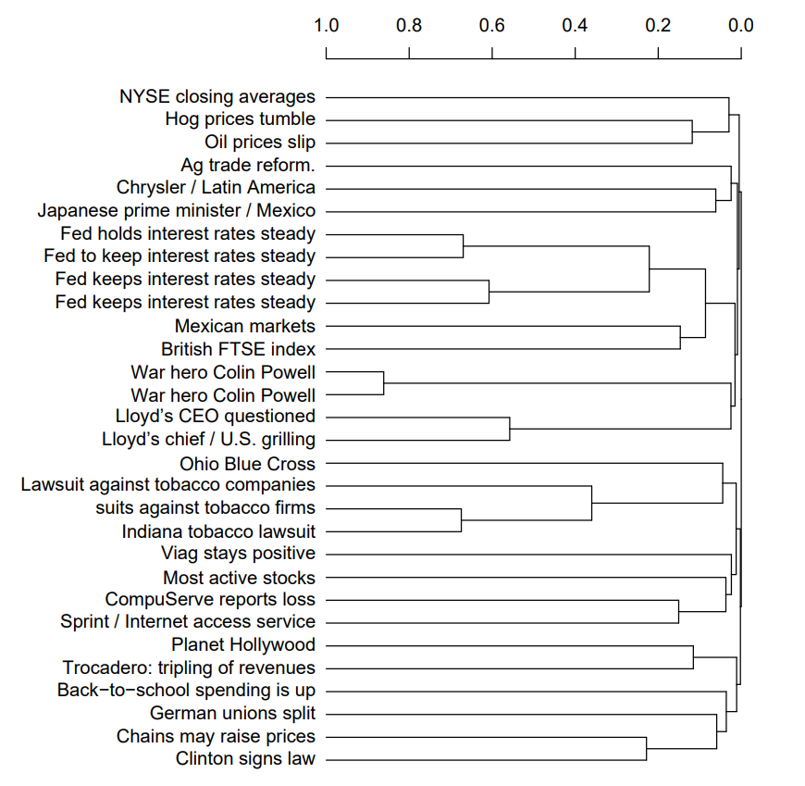
17.2 Single-link and complete-link clustering
chaining

Slide 10
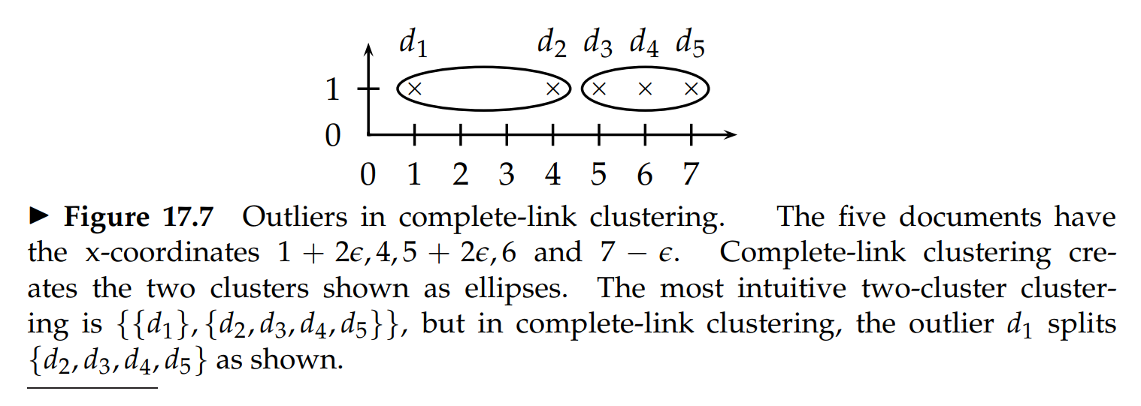
17.2 Single-link and complete-link clustering

Slide 11
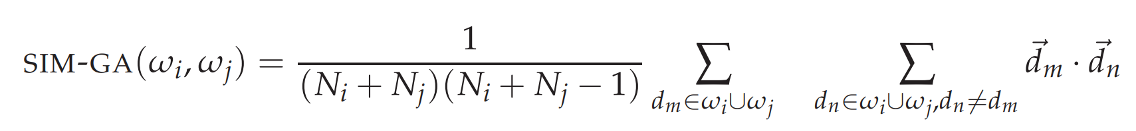
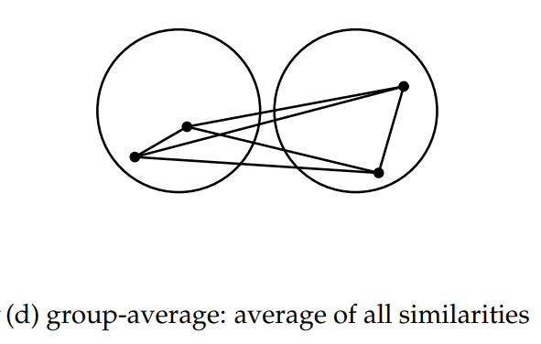
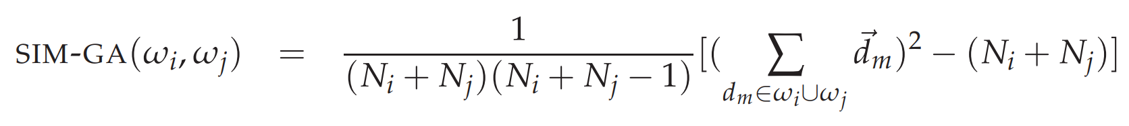
17.3 Group-average agglomerative clustering
Documents represented as vectors.
Length normalization of vectors, so that self-similarities are 1.0.
The dot product as the measure of similarity between vectors and sums of vectors.

Slide 12
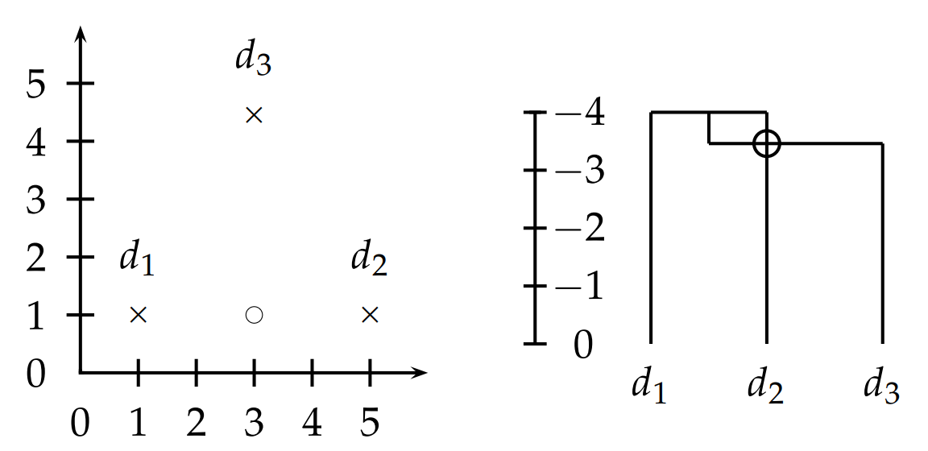
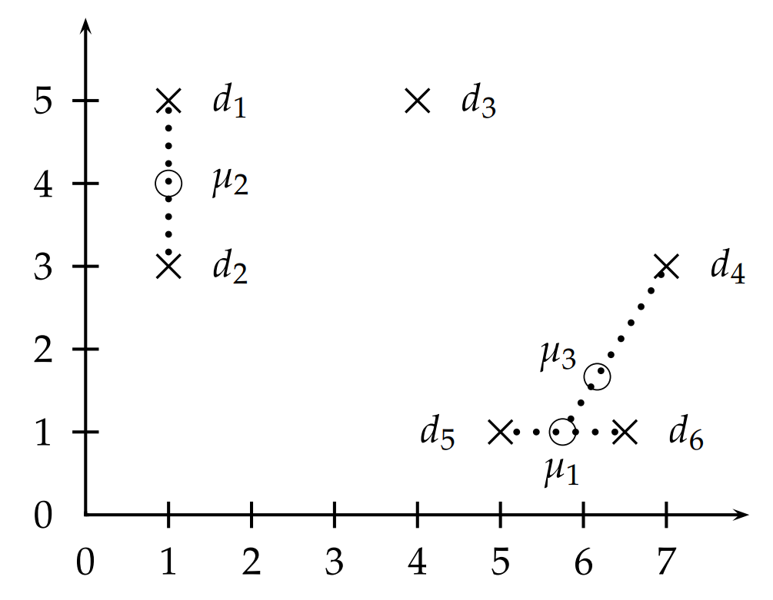
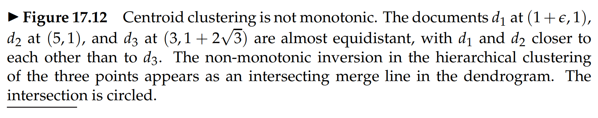
17.4 Centroid clustering
Despite its non-monotonicity, centroid clustering is often used because its similarity measure – the similarity of two centroids – is conceptually simpler than the average of all pairwise similarities in GAAC.

Slide 13
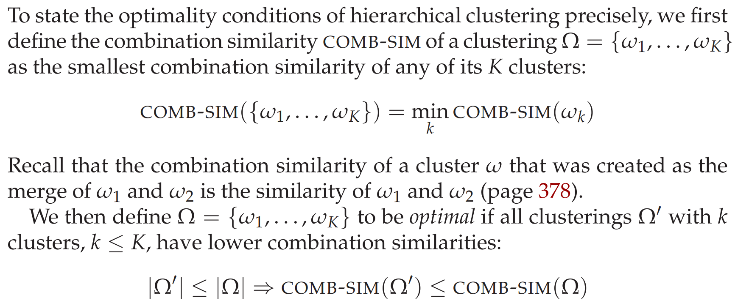
17.5 Optimality of HAC

Slide 14
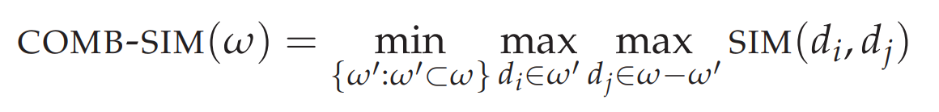

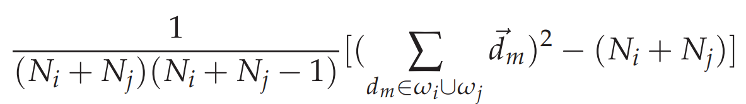
17.5 Optimality of HAC
<Note> Centroid clustering is not optimal because inversions can occur. So, the previous definition of optimality
would be of limited use if it was only applicable to a clustering together with its merge history.
The remaining are as follows:
single-link
complete-link
GAAC

Slide 15
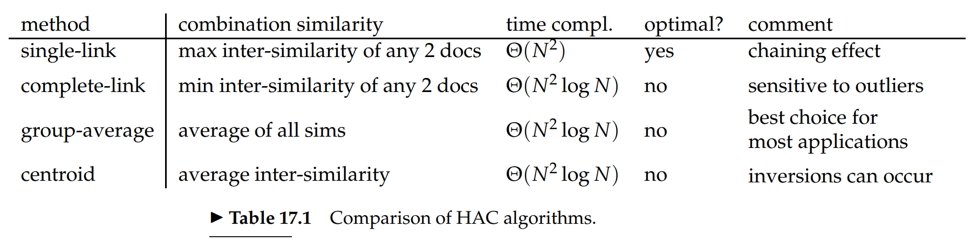
17.5 Optimality of HAC
There are two exceptions to this recommendation:
For non-vector representations, GAAC is not applicable.
The purpose of clustering is not to create a complete hierarchy or exhaustive partition of the entire set.
(for instance, first story detection or novelty detection)

Slide 16
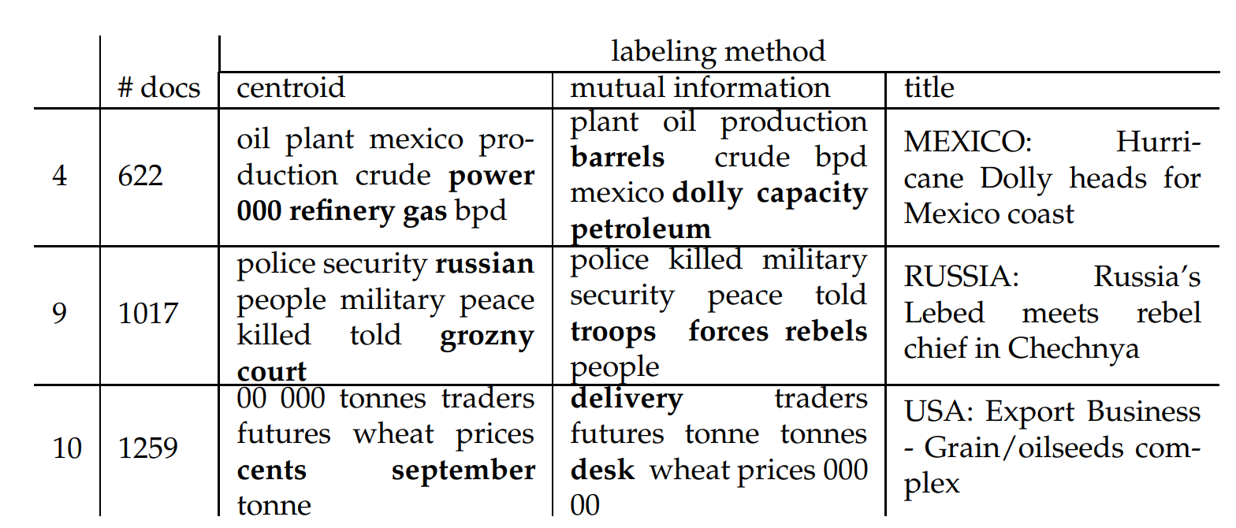
17.7 Cluster labeling
cluster-internal labeling
differential cluster labeling
For hierarchical clustering, additional complications arise in cluster labeling.

Slide 17
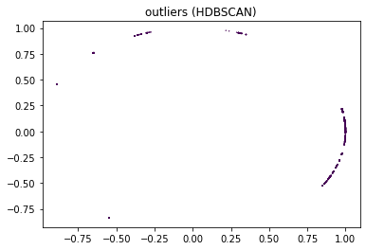
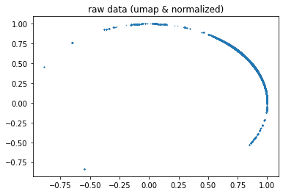
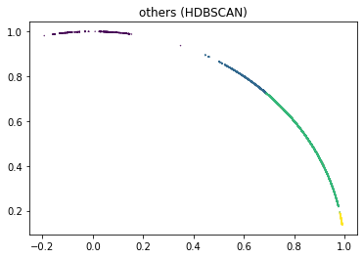

Slide 18
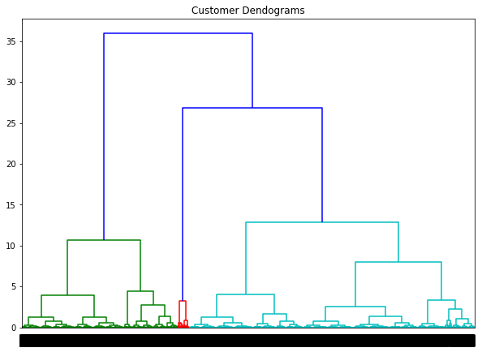
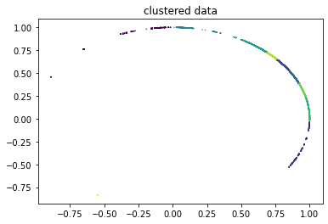
method='ward'

Slide 19
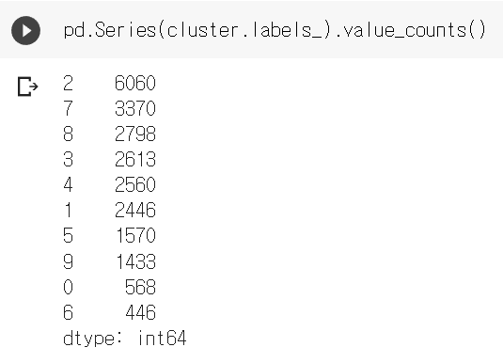
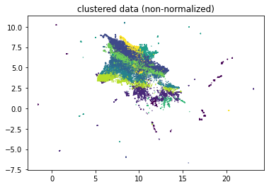

Slide 20
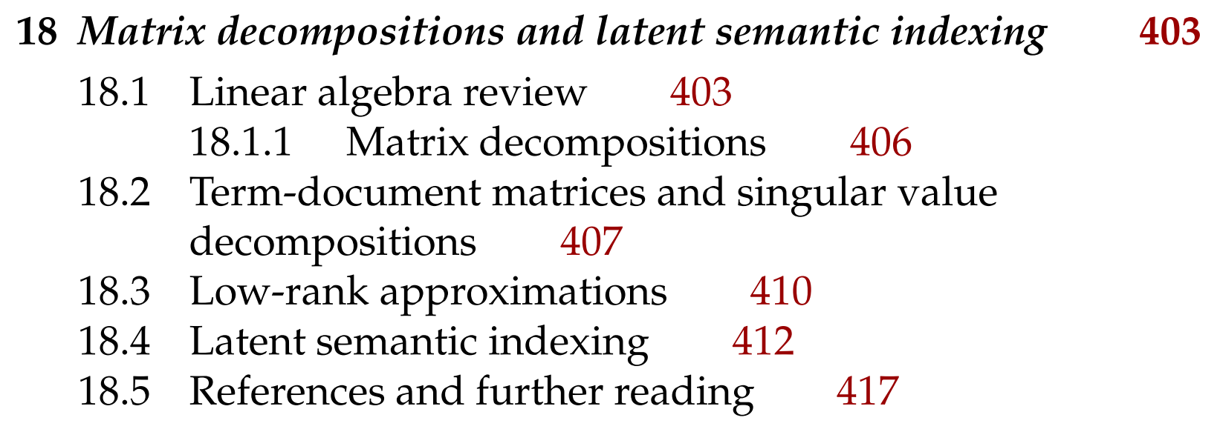
Next

